Slide 1
The new Fast Path technology
Matteo Bottazzi
EPV Technologies

Slide 2
Agenda
Introduction
Placement
User Fast Path Creation
User Fast Path Installation
Summary

Slide 3
Introduction

Slide 4
Introduction
Fast Path is part of the EPV for z/OS menu
It allows you to quickly reach sets of EPV for z/OS reports
There are two kinds of Fast Paths
EPV -> standard, NOT editable
USER -> the new one, completely customizable
With the new Fast Path technology you can now create multiple Fast Paths and organize them as you want

Slide 5
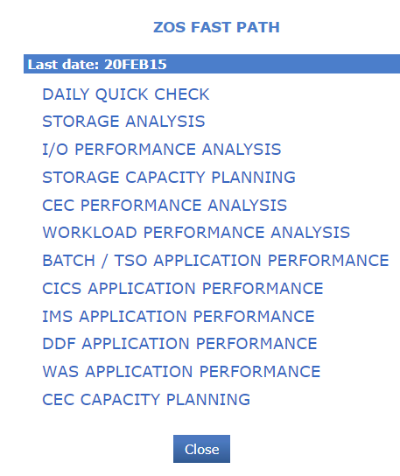
Introduction
It is divided in sections

Slide 6
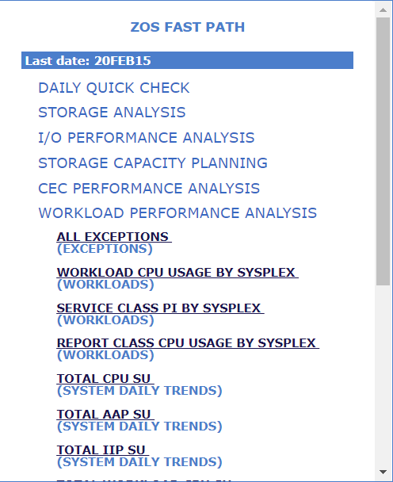
Introduction
Each section contains a list of reports

Slide 7
Placement

Slide 8
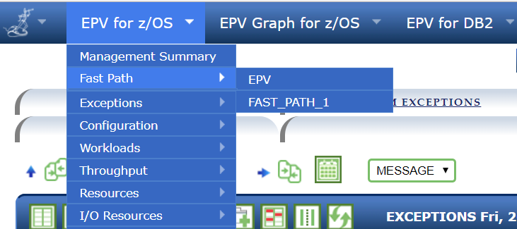
Placement
You can reach the Fast Path by clicking on the EPV for z/OS menu

Slide 9
Placement
If you click on one of them, the Fast Path opens on the top-right corner of the page
EPV for z/OS standard Fast Path

Slide 10
Creation

Slide 11
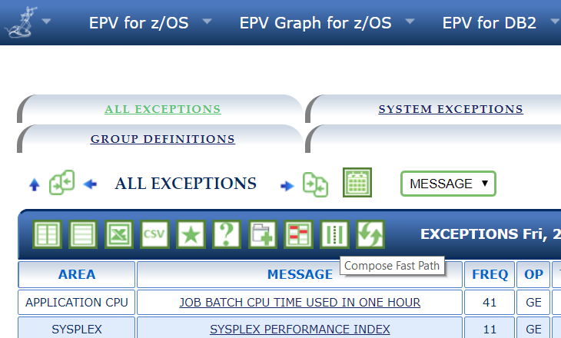
User Fast Path Creation
Open one EPV for z/OS page and click on the ‘Compose Fast Path’ button on the report

Slide 12
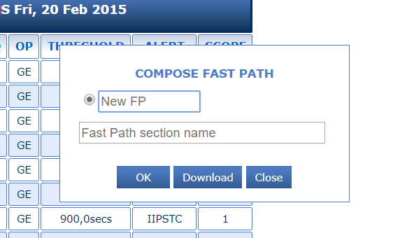
User Fast Path Creation
Enter the new Fast Path name and the section where you want to add the selected report
Fast Path Name
Fast Path Section

Slide 13
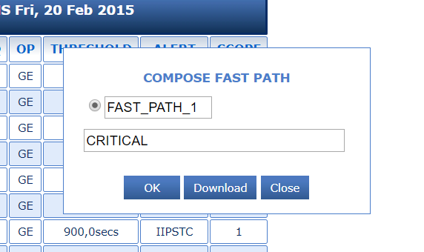
User Fast Path Creation
Click OK to continue in the new Fast Path creation

Slide 14
User Fast Path Creation
Go to the next report that you want to add to your Fast Path and click again on the button: this time the name and the section are automatically provided

Slide 15
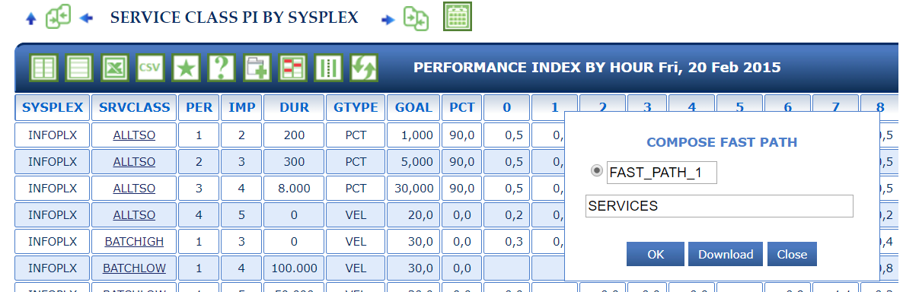
User Fast Path Creation
If you want to add one report to a different section you just need to change the section field

Slide 16
User Fast Path Creation
Once you’ve finished composing your Fast Path, press the Download button

Slide 17
User Fast Path Creation
Fast Path TXT file is now in your browser’s download folder

Slide 18
Installation

Slide 19
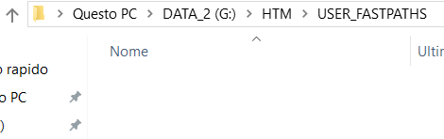
User Fast Path Installation
In order to install it, 2 actions are needed by the EPV Administrator
Action 1: copy the downloaded TXT file to the HTM/USER_FASTPATHS folder

Slide 20
User Fast Path Installation
Action 2: add the Fast Path name (without the FP prefix) to the list in the UserFastPaths variable located in HTM/JAVA/EPV_CONFIG_V14.TXT

Slide 21
User Fast Path Installation
Now, just refresh (F5) your browser: FAST_PATH_1 will now appear inside the Fast Path menu

Slide 22
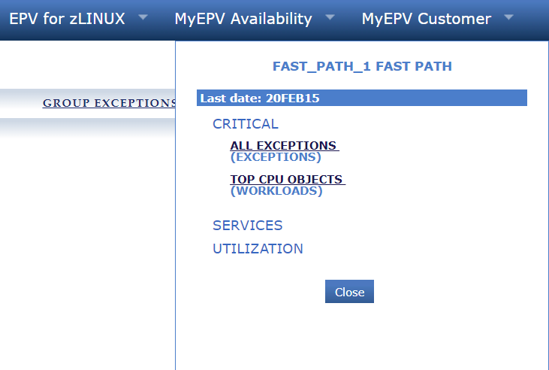
User Fast Path Installation
This is a simple example of how the User Fast Path could look like
Example of User Fast Path

Slide 23
Summary

Slide 24
Summary
User Fast Path creation can be done by any EPV user online and independently
User Fast Path installation must be done by the EPV administrator
EPV for z/OS V14 natively supports this new feature
EPV for z/OS V14 is GA since April 2017
A free trial can be easily arranged

Slide 25
Questions?
matteo.bottazzi@epvtech.com
epv.support@epvtech.com
www.epvtech.com

